Slide 1
Threads (operating System)
Chapter 4

Slide 2
What is Thread ?
A thread is a basic unit of CPU utilization.
A thread is a flow of execution through the process code, with its own program counter, system registers and stack.
A thread is also called a light weight process.
Threads provide a way to improve application performance through parallelism. Each thread belongs to exactly one process and no thread can exist outside a process.

Slide 3
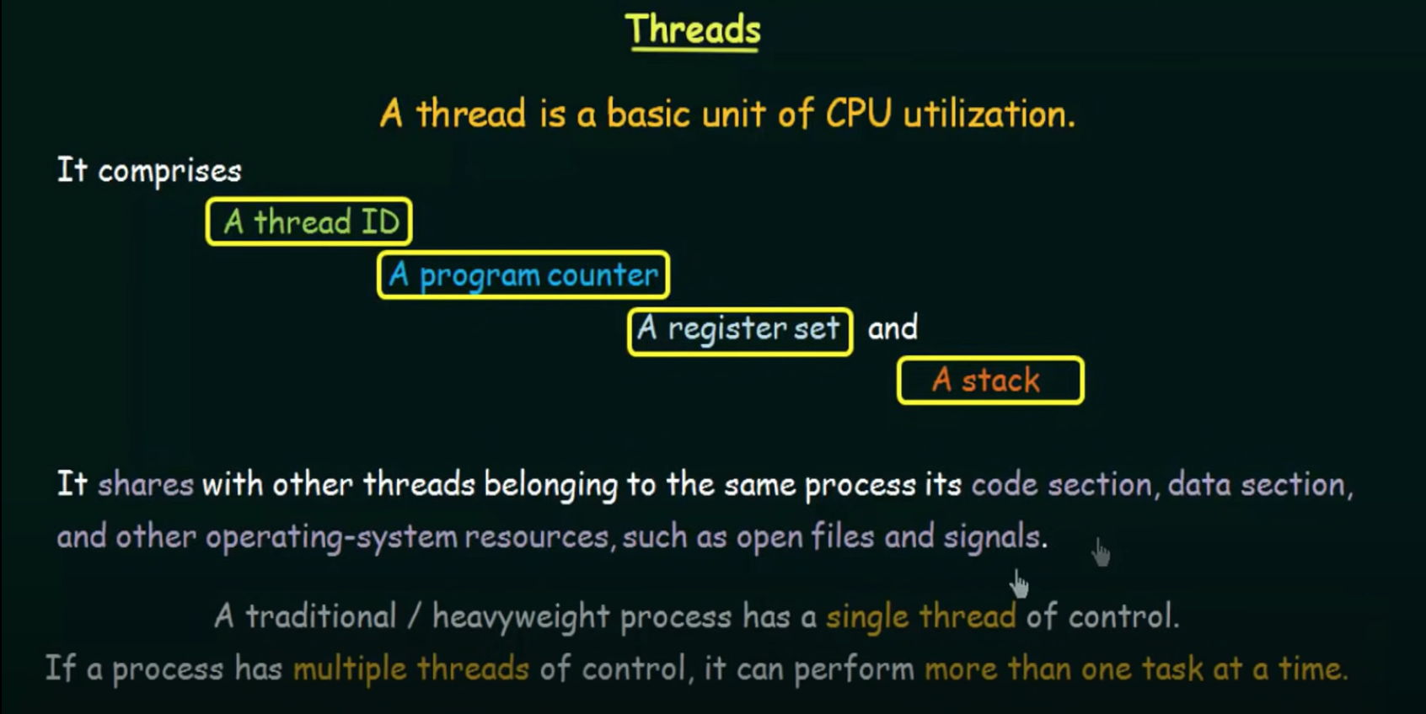
Notes:
A stack is a special area of computer's memory which stores temporary variables created by a function.
A program counter (PC) is a CPU register in the computer processor which has the address of the next instruction to be executed from memory.

Slide 4
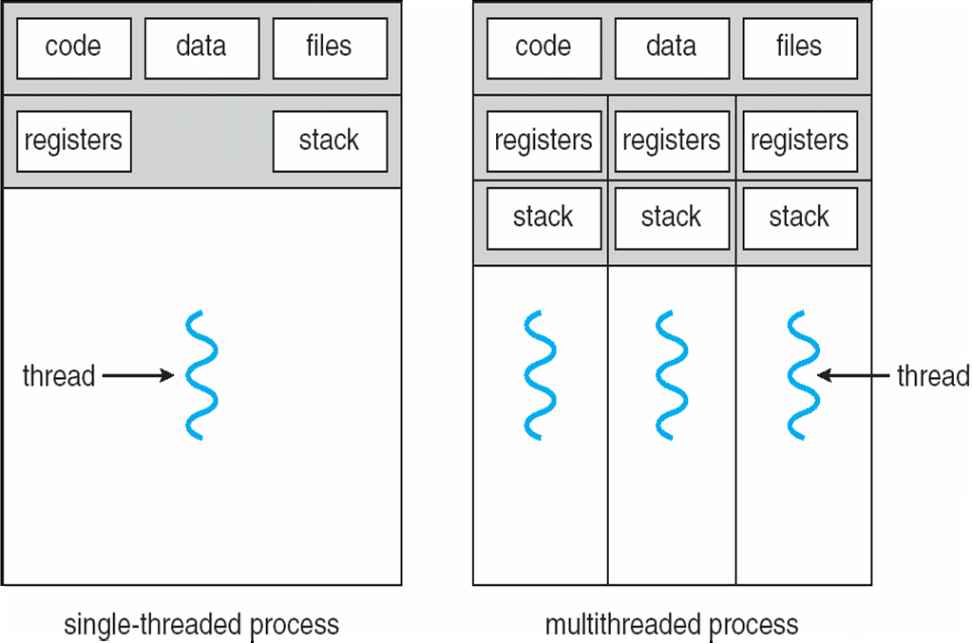
Single threaded Process and Multi-threaded Process

Slide 5
Difference between Process and Threads
Process
Process is heavy weight or resource intensive.
Process switching needs interaction with operating system.
In multiple processing environments each process executes the same code but has its own memory and file resources.
If one process is blocked then no other process can execute until the first process is unblocked.
Multiple processes without using threads use more resources.
In multiple processes each process operates independently of the others.
Threads
Thread is light weight taking lesser resources than a process.
All threads can share same set of open files, child processes.
While one thread is blocked and waiting, second thread in the same task can run.
Multiple threaded processes use fewer resources
One thread can read, write or change another thread's data.

Slide 6
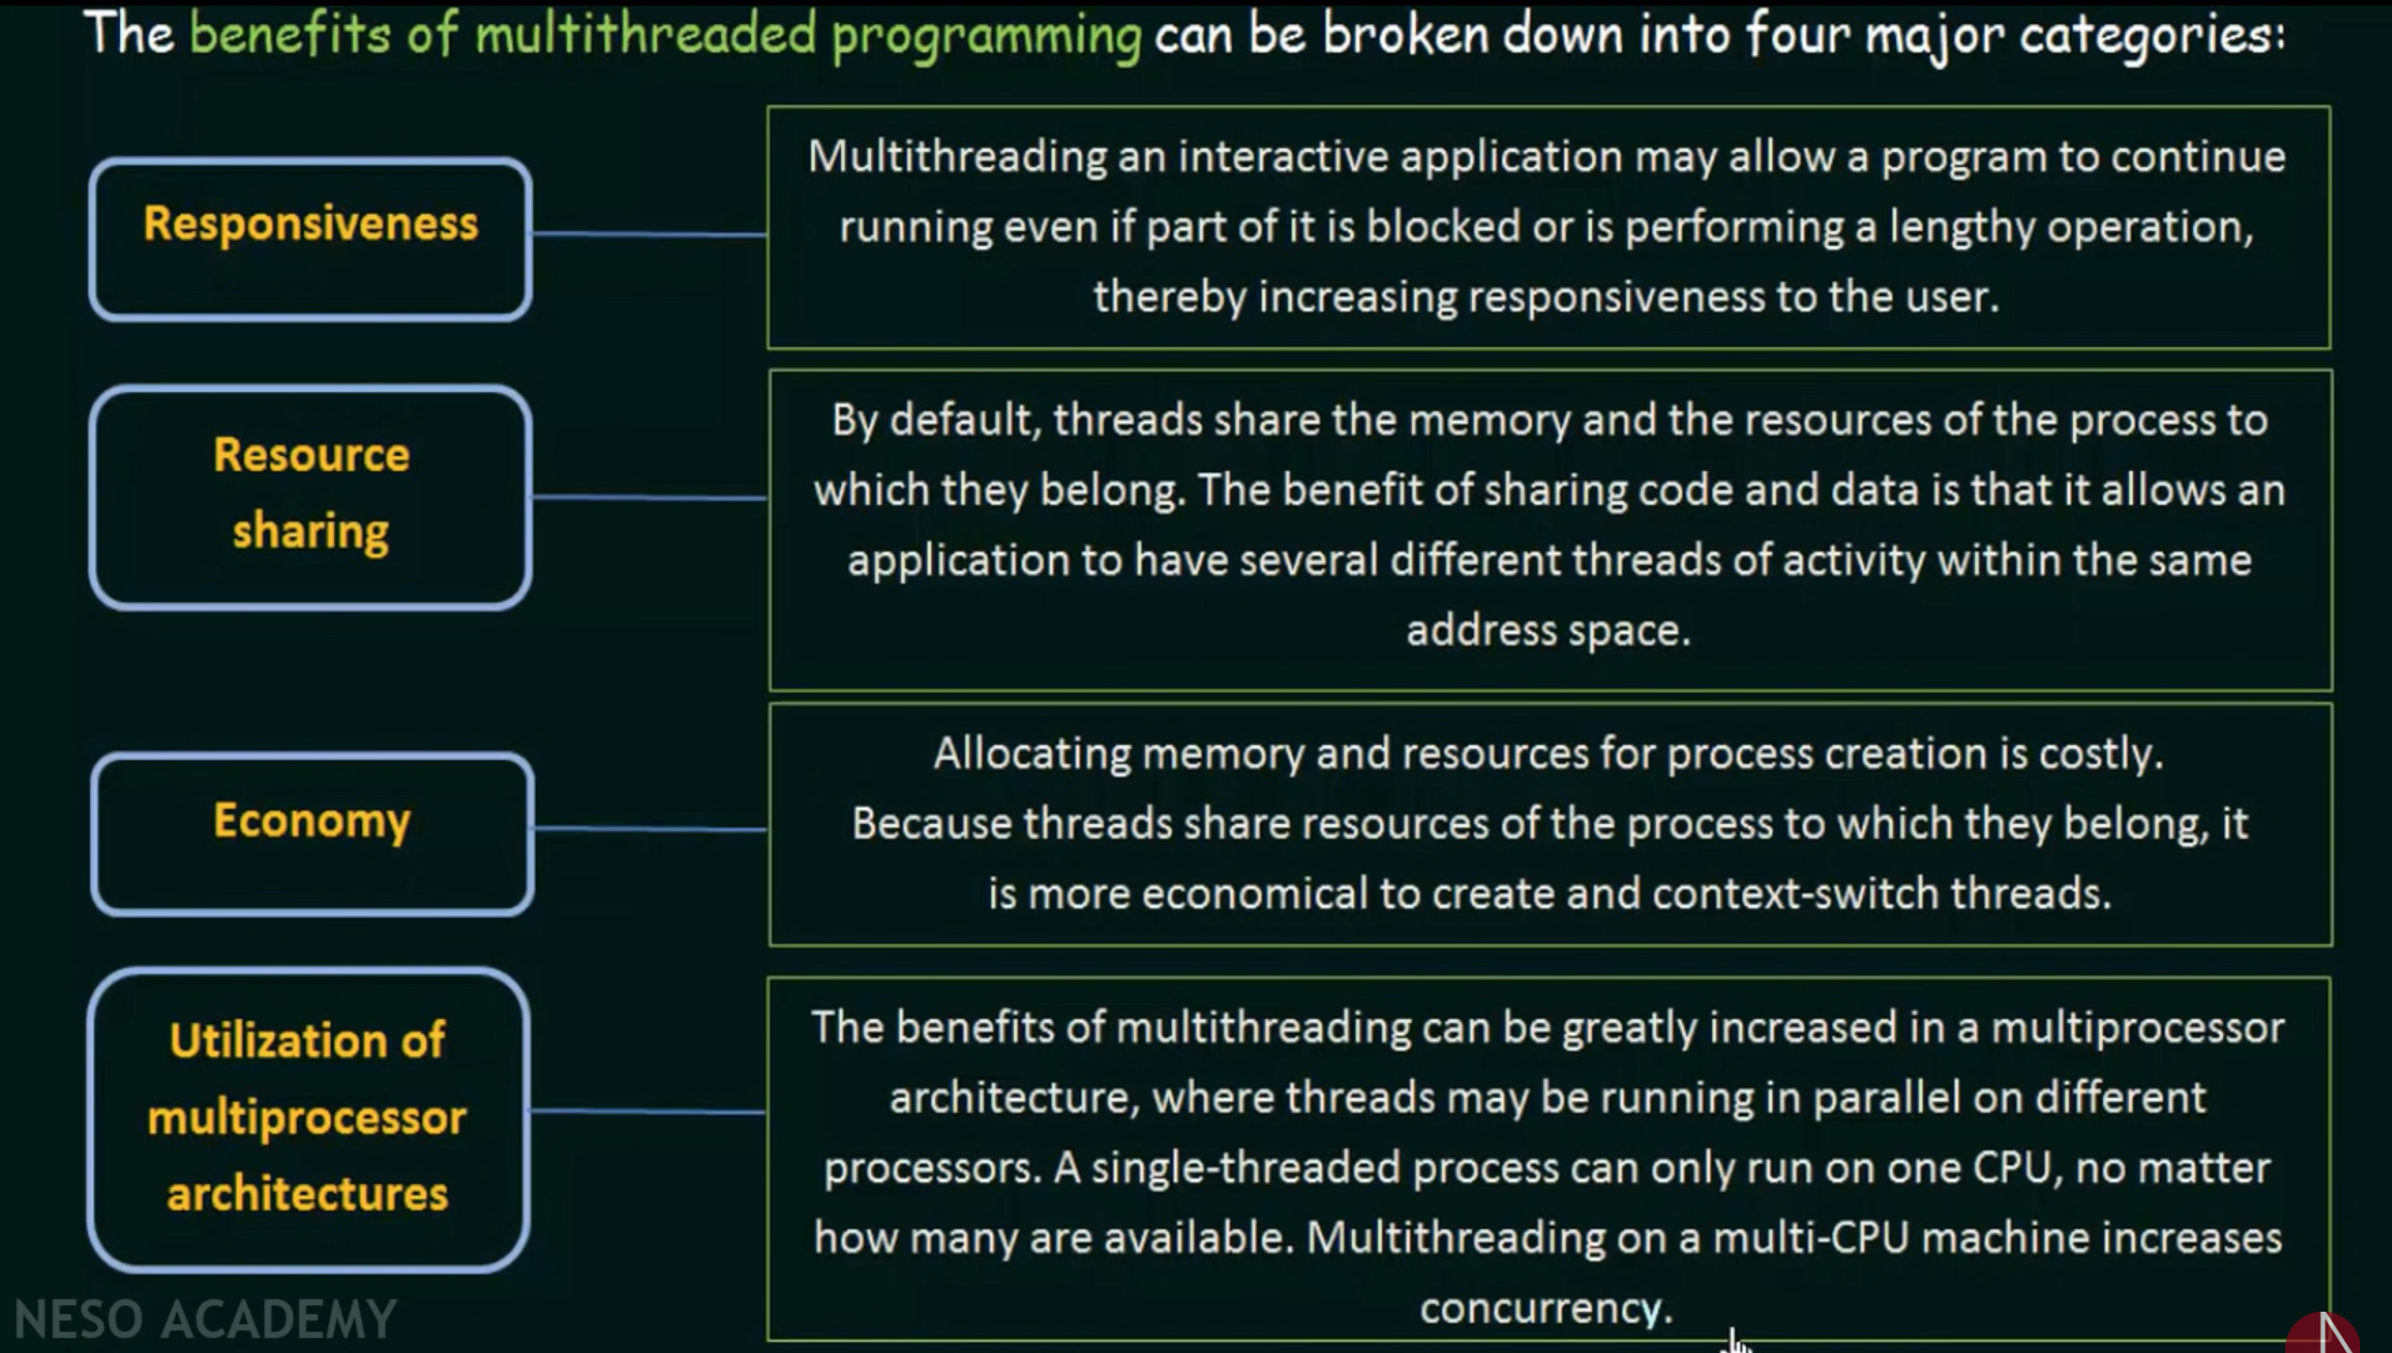
Benefits of Threads :
Notes:
Address space is the amount of memory allocated for all possible addresses for a computational entity, such as a device, a file, a server, or a networked computer.

Slide 7
Multicore Programming
On a system with a single computing core, concurrency merely means that the execution of the threads will be interleaved over time, because the processing core is capable of executing only one thread at a time.
On a system with multiple cores, however, concurrency means that the threads can run in parallel, because the system can assign a separate thread to each core

Slide 8
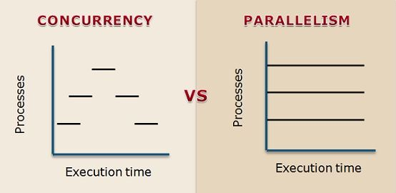

Slide 9
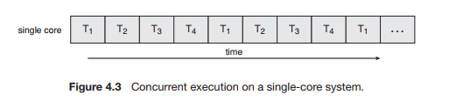
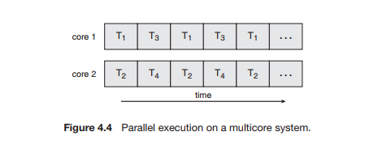

Slide 10
CPU schedulers were designed to provide the illusion of parallelism by rapidly switching between processes in the system,
thereby allowing each process to make progress.
Such processes were running concurrently, but not in parallel
Systems have grown from tens of threads to thousands of threads,
CPU designers have improved system performance by adding hardware to improve thread performance.

Slide 11
Multicore Programming
In general, five areas present challenges in programming for multicore systems:
Identifying tasks. This involves examining applications to find areas that can be divided into separate, concurrent tasks.
Balance. While identifying tasks that can run in parallel, programmers must also ensure that the tasks perform equal work of equal value.
Data splitting. Just as applications are divided into separate tasks, the data accessed and manipulated by the tasks must be divided to run on separate cores.
Data dependency. The data accessed by the tasks must be examined for dependencies between two or more tasks. When one task depends on data from another, programmers must ensure that the execution of the tasks is synchronized to accommodate the data dependency

Slide 12
Testing and debugging. When a program is running in parallel on multiple cores, many different execution paths are possible. Testing and debugging such concurrent programs is inherently more difficult than testing and debugging single-threaded applications.

Slide 13
Types of Parallelism
In general, there are two types of parallelism: data parallelism and task parallelism.
Data parallelism focuses on distributing subsets of the same data across multiple computing cores and performing the same operation on each core.
Task parallelism involves distributing not data but tasks (threads) across multiple computing cores. Each thread is performing a unique operation.
Different threads may be operating on the same data, or they may be operating on different data.
Data parallelism involves the distribution of data across multiple cores and task parallelism on the distribution of tasks across multiple cores

Slide 14
Types of Threads :
Threads are implemented in following two ways :
User Level Threads (ULT)
Kernel Level Threads (KLT)

Slide 15
User Level Threads (ULT) :
User level thread implement in user level libraries, so thread switching does not need to call operating system and to cause interrupt to the kernel.
In fact, the kernel knows nothing about user level threads and manages them as if they were single-threaded process.
Notes:
User-level threads allow an extremely specialized scheduling algorithm.

Slide 16
User Level Threads (ULT) :
Advantages of ULT :
User level threads does not require modification to operating system.
Easy to represent and manage.
User level thread can run on any operating system.
User level threads are fast and efficient.
Disadvantages of ULT :
There is a lack of coordination between threads and operating system kernel.
ULT require non-blocking system call (i.e. Multithreaded kernel)

Slide 17
Kernel Level Threads (KLT) :
In this method, the kernel knows about and manages the threads. No runtime system is needed in this case.
Operating system kernel provides system call to create and manage threads.

Slide 18
Kernel Level Threads (KLT) :
Advantages of KLT :
Kernel can simultaneously schedule multiple threads from the same process on multiple processes.
If one thread in a process is blocked the kernel can schedule another thread of the same process.
Kernel routines themselves can multithreaded.
Disadvantages of KLT :
Kernel thread are generally slower to create and manage than the user threads.
Kernel requires Thread Control Block (TCB) for each thread in the pool, hence complexity increases.

Slide 19
Difference between ULT and KLT
User Level Thread
User level thread are faster to create and manage.
Implementation is by a thread library at the user level.
ULT is generic and can run on any operating system.
Multi-Threaded can not take advantages of multiprocessing.
Kernel Level Thread
Kernel level thread are slower to create and manage.
Operating system supports creation of kernel level threads.
KLT is specific to the operating system.
Kernel routines themselves can be multithreaded.

Slide 20
Multithreading Models
Many-to-One (User Level Threading)
One-to-One (Kernel Level Threading)
Many-to-Many (Hybrid Threading)

Slide 21
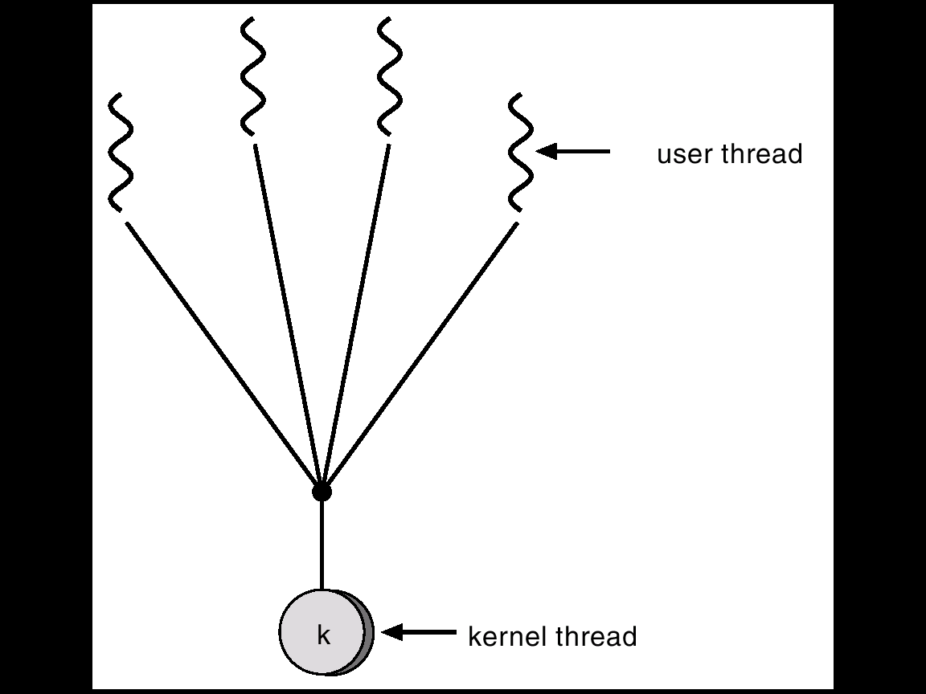
Many-to-One (User Level Threading)
Many user-level threads mapped to single kernel thread.
Kernel thread can be thought of as the main process
If one thread blocks, the entire process blocks
Examples:
Solaris Green Threads
GNU Portable Threads

Slide 22
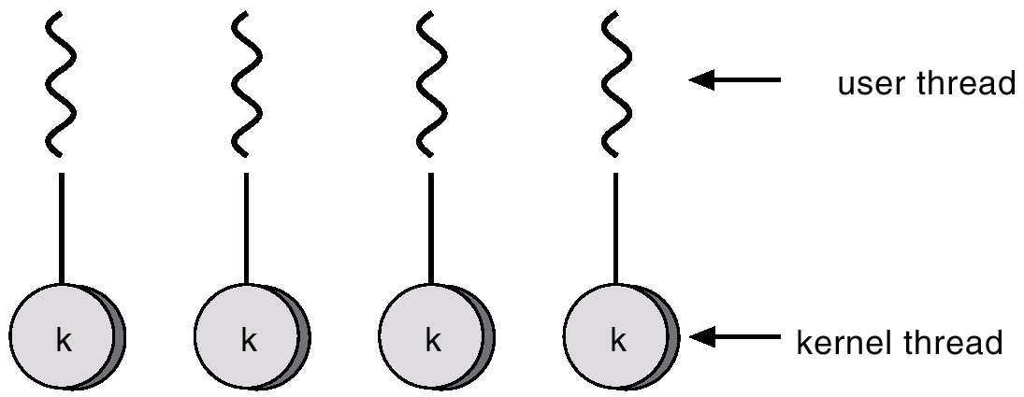
One-to-One
Each user-level thread maps to kernel thread.
Each thread is independently schedulable by the kernel, so if one thread blocks, others can still run.
Examples
- Windows 95/98/NT/2000
- Linux

Slide 23
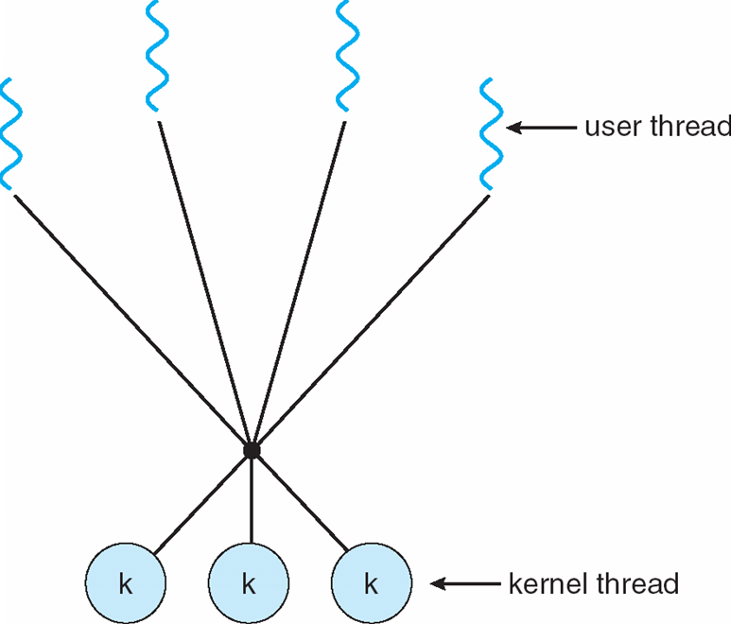
Many-to-Many (Hybrid Threading)
Allows many user level threads to be mapped to many kernel threads
More complex to implement than either kernel or user threads
E.g. Windows 2000 with the ThreadFiber package

Slide 24
Thread Libraries
A thread library provides the programmer an API for creating and managing threads.
There are two primary ways of implementing a thread library.
The first approach is to provide a library entirely in user space with no kernel support.
The second approach is to implement a kernel-level library supported directly by the operating system.
Three main thread libraries are in use today: (1) POSIX Pthreads, (2) Win32, and (3) Java. Pthreads
Notes:
API=Application Programming Interface

Slide 25
Threading Issues
Semantics of fork() and exec() system calls
Thread cancellation of target thread
Asynchronous or deferred
Signal handling
Thread pools
Thread-specific data
Scheduler activations

Slide 26
Semantics of fork() and exec() system calls
The fork () function creates a copy of the process.
Recall that when fork() is called, a separate, duplicate process is created
How should fork() behave in a multithreaded program?
Should all threads be duplicated?
Should only the thread that made the call to fork() be duplicated?
The exec() system call continues to behave as expected .
Replaces the entire process that called it, including all threads.

Slide 27
Thread Cancellation
Thread cancellation is the act of terminating a thread before it has completed.
Example - clicking the stop button on your web browser will stop the thread that is rendering the web page
The thread to be cancelled is called the target thread
Threads can be cancelled in a couple of ways
Asynchronous cancellation terminates the target thread immediately Thread may be in the middle of writing data ... not so good.
Deferred cancellation allows the target thread to periodically check if it should be cancelled .Allows thread to terminate itself in an orderly fashion.

Slide 28
Signal Handling
Signals are used in UNIX systems to notify a process that a particular event has occurred
A signal handler is used to process signals
Signal is generated by particular event
Signal is delivered to a process
Signal is handled
In a multithreaded program, where should signals be delivered? - Options:
Deliver the signal to the thread to which the signal applies
Deliver the signal to every thread in the process
Deliver the signal only to certain threads in the process
Assign a specific thread to receive all signals for the process

Slide 29
Thread Pools
In applications where threads are repeatedly being created/destroyed thread pools might provide a performance benefit.
A thread pool is a group of threads that have been pre-created and are available to do work as needed.
Threads may be created when the process starts
A thread may be kept in a queue until it is needed
After a thread finishes, it is placed back into a queue until it is needed again
Avoids the extra time needed to spawn new threads when they’re needed

Slide 30
Thread-specific data
Allows each thread to have its own copy of data.
Useful when you do not have control over the thread creation process (i.e., when using a thread pool).

Slide 31
Scheduler activations
Many to Many models require communication to maintain the appropriate number of kernel threads allocated to the application.
Scheduler activations provide upcalls - a communication mechanism from the kernel to the thread library.
This communication allows an application to maintain the correct number kernel threads.

